Slide 1
Customer Management
Introduction to Coursework 2
Dr. Nurdilek Dalziel
Week 15

Slide 2
Learning Objectives
Introducing coursework 2
Offering tips on how to draft your report in a time-efficient way

Slide 3
Your Experience of Coursework 1
www.menti.com
Code: 26 37 26

Slide 4
Recapping CW1
Customer acquisition, retention and development
Taking into account the key customer segment of the organisation, what customer acquisition, retention and development strategies would be most beneficial?
Sustainable customer management
By applying two theoretical frameworks learnt in this model (such as Kano model, Gartner competency model, IDIC model, CRM value chain), discuss how the organisation can design a sustainable customer management strategy.

Slide 5
Coursework Two
Deadline: Friday 3rd April 2020, at 12pm (MID-DAY) via Turnitin
Word Count: 1,500 words (+/- 10%)
Weighting: 50%

Slide 6
Coursework 2
Learning Objectives to be Assessed:
Make recommendations on how an organisation can improve its CRM performance and profitability
Develop problem solving and decision-making skills

Slide 7
Having designed a sustainable customer management strategy for your organisation (Coursework 1), you are asked to recommend a digital and social customer relationship management (CRM) strategy to the organisation to enhance its relationship with its customers.

Slide 8
Section 1 (750 words; 50%)
Digital and social CRM literature review
Section 2 (750 words; 50%)
Recommending a digital and social CRM strategy to your organisation

Slide 9
Digital and Social CRM:
Week 8 (CRM to Social CRM: Part 1)
Week 18 (CRM to Social CRM: Part 2)
Week 19 (Digital Customer Experience)

Slide 10
Recommended Report Structure
Title Page (Title of the report, Student number, Module name & code, Tutor name, Submission date, Word count) (NOT part of word count)
Table of Contents (NOT part of word count)
Organisation Summary (NOT part of word count)
Section 1: Literature Review (included in word count)
Section 2: Recommendations (included in word count)
Reference List (NOT part of word count)
Appendices (if applicable) (NOT part of word count)

Slide 11
Presentation
Please use ‘1.15 lines’ spacing and 11 point Calibri (default).
Word count is for Sections 1 & 2. Title page, table of contents, organisation summary, reference list, appendices, tables, graphs and figures used within the main body of the report are excluded from the word count.
Report needs to be structured well, professional looking, clearly expressed points in English, adopt careful punctuation and appropriate use of paragraphs (including the choice of terminology, spelling and grammar), and Harvard referencing.

Slide 12
Section 1 (750 words; 50%):
Digital and social CRM literature review

Slide 13
Tips on Literature Review

Slide 14
www.library.dmu.ac.uk
Click on “Search & Find”
Click on “Database A-Z”
Click on “All Databases”
Select “B” for “Business Source Complete” and click on it

Slide 15
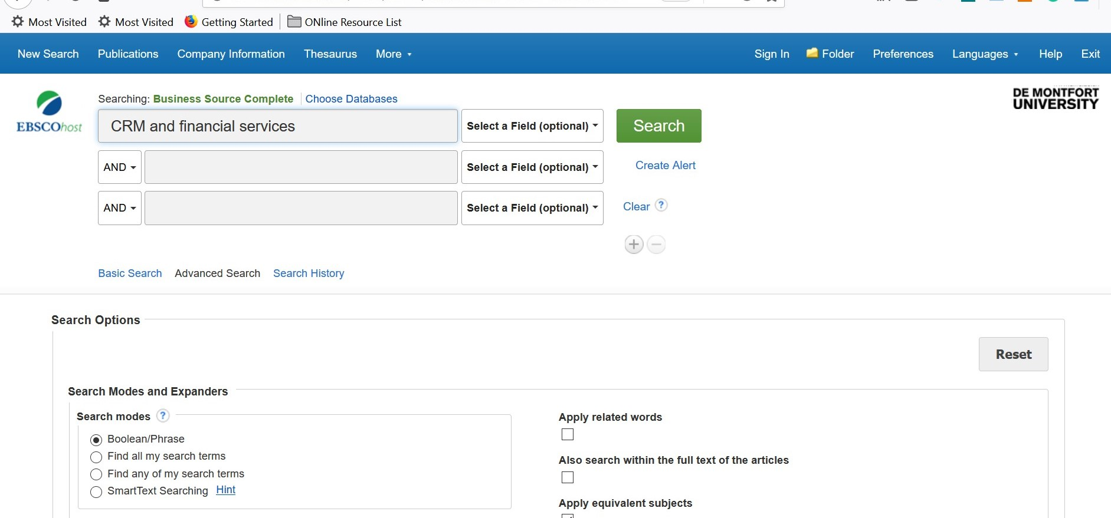
Key in CRM and Financial Services in Search Box and Hit Search

Slide 16
Refine Your Search By Selecting:
Scholarly (Peer-Reviewed) Journals
Source Type: Academic Journals
Subject: Customer service management
Publication Date: From 2000
Language: You can decide which language(s) you want to focus on

Slide 17
You Can Further Refine Your Search Through ‘Advanced Search’ Box
Change ‘Select a Field’ box to ‘AB Abstract’
Hit ‘Search’

Slide 18
Result
I managed to reduce my journal papers from 803 to 3 in a few seconds by merely refining my search.
803
3
Tips: Refining your search is the best way to use your time efficiently.

Slide 19
How to Expand Your Reference List in a Relatively Short Time:
Use “Cited References” & “Times Cited in This Database” functions
Cited References: Sources which were listed in the reference list of the given paper.
Times Cited in This Database: Sources which were published after the given paper which cited the paper in their reference list.

Slide 20
Can you Challenge Yourself by Identifying a min of 10 Good Quality Papers For Your Assignment?

Slide 21
Dr. Nurdilek Dalziel
Senior Lecturer in Marketing
Programme Leader: Business & Marketing
Office: HU4.87
Office Hours: Monday 9-11am; no need to book an appointment
Tel: 0116 250 6371

